Slide 1
What to expect from Year 7

Slide 2
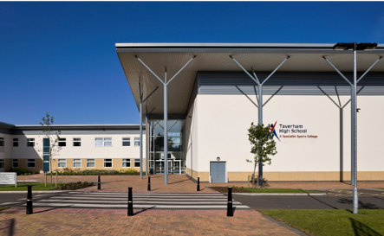
To Taverham High School
We are really looking forward to welcoming you all to be part of our school community.
In this presentation you will find useful information, photos of people you will meet and places your child will discover in September.

Slide 3
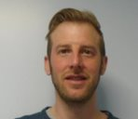
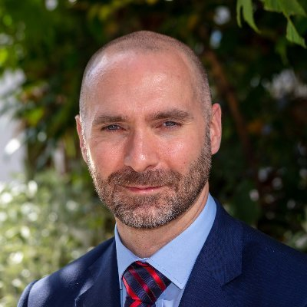
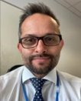
Mrs. Ricketts:
Deputy Head Teacher
Safeguarding, behaviour and welfare
Mr. Hyett:
Assistant Head Teacher
Teaching and Learning
SENIOR
LEADERSHIP
TEAM
Mr. Day:
Assistant Head Teacher
PD, equality and diversity
Mr. Yassin:
Deputy Head Teacher
Curriculum
Dr. Harris:
Head Teacher
Mr. Linnell:
Head of 6th Form

Slide 4
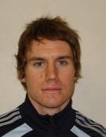
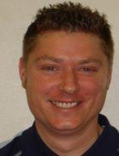
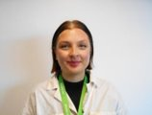
Mr. Blowers:
Behaviour Lead
My role is to review behaviour on a daily basis and support Head of Year in following up negative and positive behaviour points.
MEET
THE
TEAM
Mr. Derrick:
Transition Lead
My role is to help with transitions to THS and make sure they're as smooth as possible. I work with students, parents and current teachers and am 1 of many people students can talk to.
Miss. Molloy
Head of Year 7
My role is to make sure students are happy, achieving and behaving in school. I will be there daily for any worries or stresses and regularly speak to parents and pastoral team.

Slide 5
WHO CAN
I SPEAK
TO
Head of Year
(Miss. Molloy)
The key roles of the Head of
Year are attendance, behaviour, bullying and welfare & guidance.
Transition Lead
(Mr. Derrick)
The key role of the Transition Lead is creating a smooth transition
for you
Form Tutor -
They should be the first person you will turn to for help or advice. A Form Tutor's role is to care for you and monitoring your progress both academically and socially making sure you succeed. Please also let them or your HOY know, as soon as
possible, if there are any problems at home or medical issues.
Student Support
(Mrs. Killington)
The role of student support is to
support welfare & guidance of our
students, their mental health &
wellbeing, safeguarding and to work
with external agencies/alternative
provision.
Behaviour Lead
(Mr. Blowers)
The key role of the Behaviour Lead is the welfare & guidance of students, seeking alternative provision &
promoting praise and rewards.

Slide 6
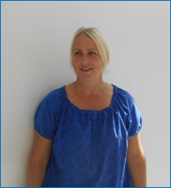
ACE TEAM
Mrs. Killington:
Student Support
My aim is to offer young people a safe environment where they feel supported to work through issues they face. I work with both students and their families with your Head of Year.

Slide 7
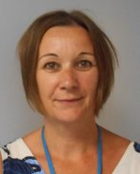
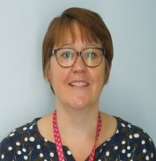
MEET
THE SEND
TEAM
Mrs. Dixon:
SENCO
Mrs. Gray:
Assistant SENCO
We are here to help with learning and to help students make the most of their time at Taverham High School. Students may meet us in lessons, in Group Intervention work or around school. We are always happy to help and can be found in our student support area.

Slide 8
CELEBRATING
SUCCESS
The school’s behaviour policy is one of positive and productive learning environment which is underpinned
by the work of Tom Bennett and linked to the work of Paul Dix: ‘The Five pillars of Pivotal practice.’
Students can accrue positives through our behaviour system, and they will be evident via MCAS. We reward positives for students being part of our TEAM and celebrate success in assemblies each week, half term and year.
Take Responsibility Everyone Safe Always respectful Make a difference
T
Be prepared
For your equipment
For your attitude
For your learning
For your homework
To always do your best
By wearing the correct uniform
By being on time
By taking pride in your work
E
Follow instructions 1st time
Quiet and listening
Moving around the school- think calm on entry & calm on exit
Don’t make contact with anyone else
Always use materials properly and safely
Ask permission to leave the room
A
To yourself
To staff and peers
For your learning and others learning
By using polite and respectful language- think before you speak!
To the community
To the environment
By promoting equality and fairness
M
To your future
To others
To the school
By being a role model
To your environment

Slide 9
YEAR 7
INDUCTION
DAY
Thursday 6th July
8.45am: Pupils arrive to Sports Hall
9.00 – 10.35: Time with Form Tutors
10.35 – 10.55 Break (on Astro)
10.55 – 11.55 Lesson 1
11.55 – 12.55 Lesson 2
12.55 – 1.15 Lunch (on Astro)
1.15 – 2.15 Activities with SSP
2.15 – 2.45 Parents can meet FT’s/HoY/SLT
2.45 Students leave from field

Slide 10
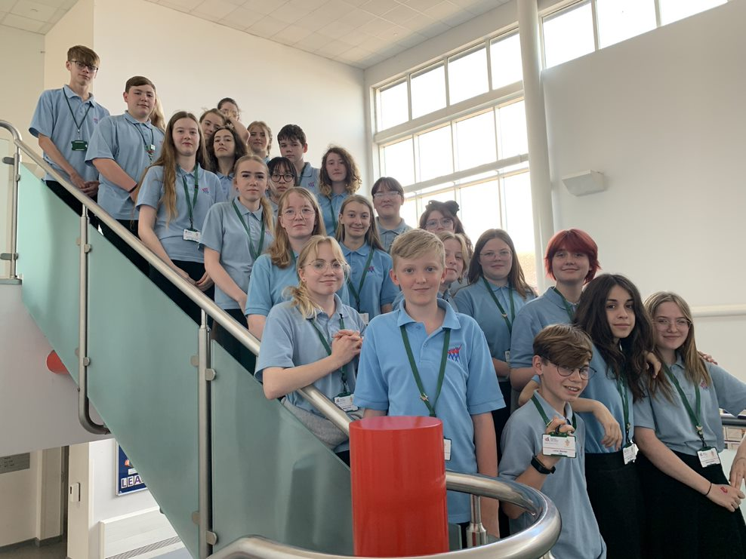
ELF
PROGRAM
An ELF is a trained peer working with the new Y7’s each year. Each Elf member is allocated to a year 7 form. They support the form tutor one day a week organising activities and getting to know the students.
The Elf team are visible in and around school as they wear a bright green lanyard, if students see them with this on it means they are available to talk to. Each Elf also has a designated day to be on duty at lunchtime.

Slide 11
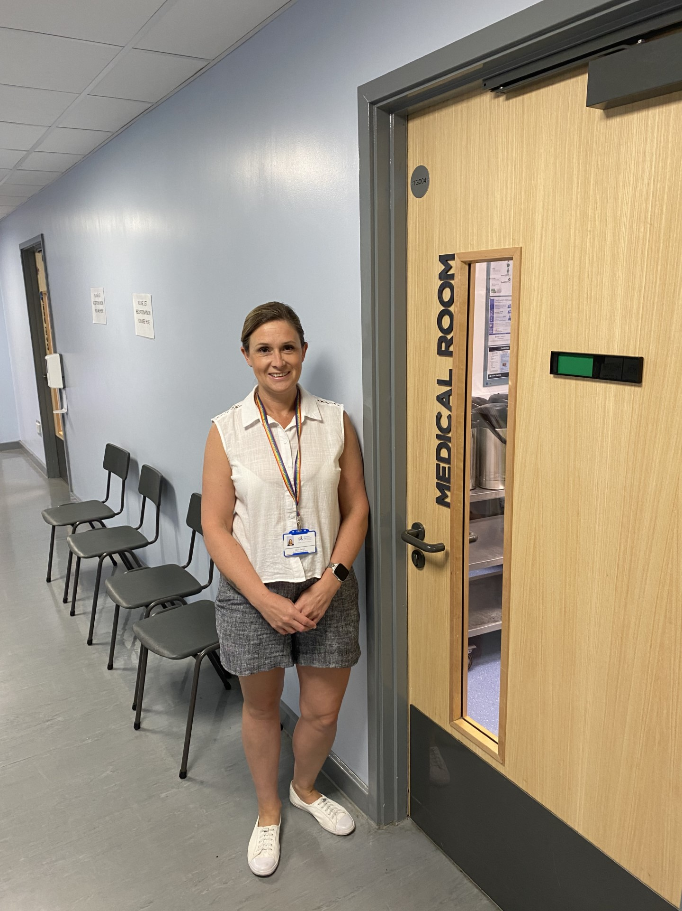
MEDICAL
ROOM
If students feel unwell during the day or need to take medication, they can visit the medical room.
They can come to the main reception at the front of school and ask to see one of our trained medical team where they will get the help they need.

Slide 12
COMMUNICATION
First Aid
If a child is unwell or hurts themselves they should go to reception for the medical staff to check if they are okay. One of the first aiders may contact parents/carers if they feel it is necessary. However, we are trying to develop their independence and resilience.
Students are not to contact parents/carers themselves
Illness
There is clear evidence that regular attendance and high achievement are linked. However, there may well be times when your child is too unwell to attend. If your child is unwell and therefore unable to attend school, it is essential to telephone the school on every day of absence, preferably by 8:30am. Please leave a message on our dedicated absence line: 01603 860505 option 1.
For absences of more than one day, parents/carers are asked to send an absence note with their child, even if a telephone call has already been made.

Slide 13
GETTING
AROUND
SCHOOL
Students may worry about finding their way around school, but I promise, it is not as confusing as it may seem. In a couple of weeks, everyone will know it like the back of their hand!!
Lessons are organised in certain blocks or buildings and there are only 5 of them.
If you are ever unsure of where to go, just ask. Anyone will be happy to help!

Slide 14
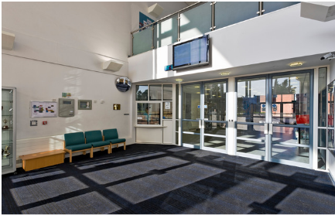
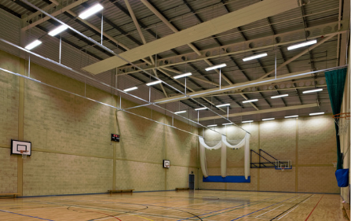
FIRST
DAY
Only Y11 and 12
Will be in!
On their first day in September, students will not use the main entrance but will come into the Sports Hall instead.
Here they will meet their Form Tutor and will be taken to their Form Rooms to continue the transition.
They will be given a chance to get to know other members of their form, find key places in the school and partake in some introductory activities.

Slide 15
THS
TIMETABLE
08:25​ | - 08:30​ | Movement time​
08:30​ | - 09:35​ | Registration & Period 1​
09:35​ | - 10:35​ | Period 2​
10:35​ | - 10:55​ | Break​
10:55​ | - 11:55​ | Period 3​
11:55​ | - 12:55​ | Period 4​
12:55​ | - 13:35​ | Lunch​
13:35​ | - 13:40​ | Movement time​
13:40​ | - 14:00​ | Assembly and/or Form Time​
14:00​ | - 15:00​ | Period 5​
Try to come in for 8:10am, so you're not late!

Slide 16
THS
LESSONS
Students will be placed in sets based on their SAT's results – we will test again in the first half term and teachers can move students if they need to
There will be around 25-30 students in each class throughout the day
Students won't be in the same groups for all classes, and all form groups will be different from your other class groups

Slide 17
THS
TIMETABLE
The name of your class group (this is a design & technology group).
Does everyone have the same timetable?
Everyone will do the same lessons over a fortnight (dependent on language choice) but not necessarily at the same time.
7L-DT1
1 Mrs G Murith
G10
Which school period it is (1-5)
The name of the teacher.
These may seem a little confusing at first but you will soon get the hang of it.
We work on a 2 week system so the lessons repeat every fortnight.
The timetable will give you the key information you will need for every session.
The room you will be in.

Slide 18
Tutor groups are random groups, as students will have a number of different subject learning groups, so it is important to make as many new friends as possible. The time spent in tutor groups is very low, it is around 20 minutes each day – this is tiny compared to the time spent in lessons!
There will be students from lots of different schools including:
Taverham, Drayton, Queens Hill, Eaton, Horsford, Hellesdon, St Peter’s & some from Home Education.
It is important that everyone feels included and students help one another make friends.
TUTOR
GROUPS

Slide 19
LEARNING
There are seven year groups in the school – Year 7 to Year 13. Within each year group students are divided into form groups with a Form Tutor. Year 7 will have 8 tutor groups – a mix from all the feeder schools. This is the chance to make new friends
In year 7 your child will study a wide range of subjects. These will be taught by
subject specialists:
English, Maths, Science, MFL, History, Geography, PD, RE, PE, Art, DT, Food Technology Music, Drama and Computer Science.
MFL: French, German and Spanish
Specialist rooms: Fully equipped science labs, purpose-built DT block, Food Technology suite, ICT facilities.
Teaching groups are not designed around friendship groups

Slide 20
TAVERHAM
HOMEWORK
We use the online system Show My Homework to record and set homework.
Reminders are set for students and you can view these at home via the website or on your phone via an app.
Students will also receive a diary to write down any set work.
How much Homework is there?
This will depend on which year group, the older students get, the more homework they get. In year 7 we look to set 30 minutes each day, which is 30 minutes per subject each fortnight.

Slide 21
COMMUNICATION
You can view key information on your child 24/7 via MCAS. This is an online portal that gives you access to key information from the school e.g. attendance, reports, negatives and positives.
The first named parental contact on the admissions form will be provided with a login and password at the start of the year. We will use the provided primary contact’s email address.
Communication from the school is emailed to parents.
Please let us know if your contact details change as soon as you can.
There will be 1 parents’ evening a year to meet with your child’s teachers.

Slide 22
COMMUNICATION
Leaving school during the day
If your child needs to leave school on any day, they must report to reception and sign the signing-out book before they go. They will not be allowed to leave school if you have not contacted the school prior to them leaving. You can ring the school, email or send a letter in with the student to be given in to reception. For the safety of our students, if we feel evidence is not legitimate, we will not let them leave.
You must send a letter in with the student, or have emailed the school if:
your child has been absent from school (even if a telephone message has already been given).
your child needs to leave school during the day for an appointment with a doctor or dentist, or for some other reason.
your child needs to be excused from PE.

Slide 23
THE HUB
If students need support with Literacy or Numeracy, they may have some lessons in the Hub. In these lessons, the staff will help with the things students find difficult, in lots of fun and interesting ways.
There is also Lego Therapy - Lego therapy has been shown to have helped many students with speech, language and communication difficulties. It helps to develop fine motor skills, and it’s FUN!
There are safe spaces upstairs by the HUB and the Head of Year's office, which students can go to. They will help to regulate student's emotions and is a safe space for a chat.

Slide 24
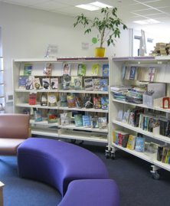
THE
LIBRARY
What are the library opening times?
The library is open 8.15am – 3pm each day.
It can be used at breaks and lunches as well as being used for some English lessons and at form time.
Miss Heydon also runs and after school homework club 3pm – 4.30pm on a Monday – Thursday. This is in an upstairs computer room rather than the library.
There’s lots to do in the library, it’s not just about books, there’s also: Games, monthly themed reading, Carnegie book award, Horrible Histories quiz and so much more!

Slide 25
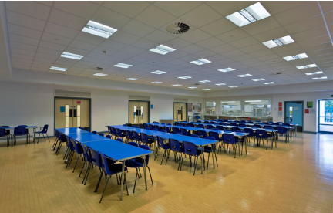
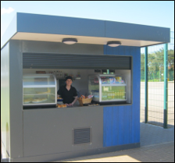
SCHOOL
FOOD
The canteen staff make delicious fresh food, both hot and cold. If you have any dietary requirements just let them know. A cashless catering system (Wisepay) has been introduced so students do not need to bring money to school. Students can also bring a packed lunch. Food is available at break and lunch times both inside and outside.
Students can eat and hang out most places, as long as it's not in the corridors or classrooms. Most of these are locked during the day.

Slide 26
MOBILE
PHONES
Students can bring a phone to school, but this must be switched off for the entire day - if you need to contact your child, please call reception and we will locate them during the day.
If a member of staff see's anyone with a phone in school, this will be confiscated, and a negative will be added to our system. Students can collect this at the end of the day. If the phone is confiscated more than once, a parent/ carer will need to collect this at the end of the day, or this would be kept at school for 5 days.

Slide 27
Uniform
All students in Years 7 to 11 are expected to wear school uniform.
Skirts must be logoed and at least knee length.
Trousers must be tailored and black, and cannot be jeans or canvas type material.
Tailored, black, knee length school shorts can also be worn; they cannot be jeans or canvas type material.
Any coat that is worn should not bear offensive or derogatory writing or images and must not be worn in class, ‘hoodies’ are not permitted in school.
School shoes must be completely black and polishable.
We do have some second hand uniform available to purchase. Please contact the main office for further details.
SCHOOL
UNIFORM
Make-up and jewellery
The following items are acceptable in school:
A single or one pair of discreet stud earrings is allowed in the earlobe. No other body piercings are acceptable. Plasters covering such piercings are not acceptable.
Discreet, natural make-up.
Natural hair colour with no extreme of fashion.
Natural nails without varnish, polish or extensions.

Slide 28
BEHAVIOUR
EXPECTATIONS
We want to make the school a positive learning environment for everyone and have a focus on eradicating low level disruption to help achieve this. All teachers use a 3 step process to support this.​
Stage 1 - Student spoken to about expectations and student rectifies behaviour.​
Stage 2 - Becomes a negative behaviour event as low-level behaviour has continued but student remains in the lesson to improve behaviour. Event is entered on BromCom as a negative.​
Stage 3 - Remains a negative behaviour event but a 20-minute detention is issued with the class teacher as behaviour has continued and student will also be removed by COT to another classroom.
When excellent behaviour is demonstrated, both in and out of the lessons, you have the opportunity to gain positives. Positives mean you can earn yourself one of our fantastic star badges and earn special rewards.
I want this year group to lead the way for kindness and good behaviour, but this will take everybody working together.

Slide 29
If you have any questions about high school or want to talk, then you can email your child's Head of Year, Miss Molloy:
y.molloy@taverhamhigh.org
Or Mr Derrick about the transition:
s.derrick@taverhamhigh.org

